Slide 1
Negative controls
Brian Caffo, Jeff Leek, Roger Peng
@bcaffo
www.bcaffo.com

Slide 2
Problem
You’re worried that your results are more do to process than real effect.
How do you check?
Negative controls - repeating the study for a variable that is known to have no association

Slide 3
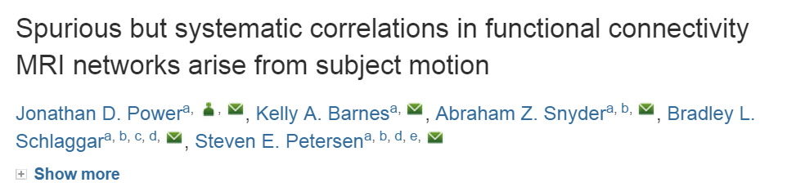
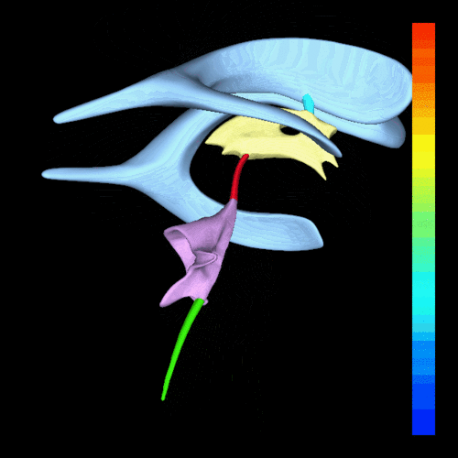
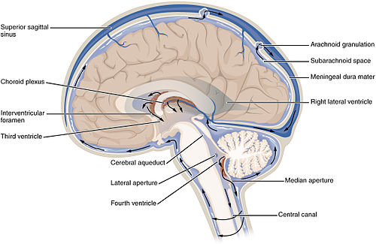
Negative controls
https://en.wikipedia.org/wiki/Ventricular_system

Slide 4
Summary
Negative controls offer a simple way to investigate spurious effects due to thinks like confounding or multiplicity
Good negative controls consider variables that are realistic, but known to have no association
Alternative strategy forces no association by permutation (more advanced and nuanced)

